Slide 1
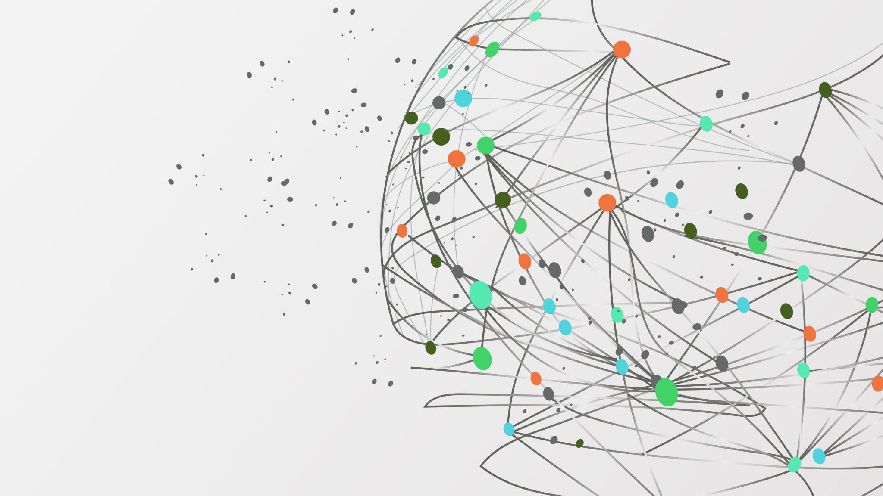
LangChain × LlamaIndex
Retrieval‑Augmented Generation & Tool‑Augmented Agents

Slide 2
Why this lecture
Previously learned: LangChain basics, tools, agents. Now: Why RAG is needed, what it is, and how LangChain & LlamaIndex complement each other.
LLMs have frozen knowledge (cutoff date).
Without external data → hallucinations or guesses.
We solve this with Retrieval‑Augmented Generation (RAG).

Slide 3
What is RAG?
Retrieval‑Augmented Generation (RAG) is a method where external documents are retrieved and supplied to the LLM as context before generating an answer.
Analogy: Closed‑book exam (no retrieval) vs Open‑book exam (with retrieval). RAG is the open‑book exam.
Key elements: - Retrieval from an external knowledge base.
Augmentation of prompts with context.
Grounded generation with citations

Slide 4
Why not rely only on LangChain?
LangChain focuses on orchestration: chaining prompts, managing agents, and tool use.
It can store data in vector databases but is limited in:
Rich indexing strategies.
Document observability.
Complex retrieval graphs.
Retrieval quality and management require more specialized tools.

Slide 5
Why LlamaIndex?
Purpose‑built for data ingestion, indexing, and retrieval.
Provides multiple index types:
Vector Index (embedding‑based similarity search).
Tree Index (hierarchical summarization).
Keyword Table (fast keyword lookups).
List Index (linear sequential documents).
Query engines: retrieval, reranking, synthesis.
Observability: inspect retrieved nodes, track provenance, debug easily.
Notes:
Vector Index
Embedding-based similarity search karta hai.
Useful jab tumhe semantic search chahiye (matlab “meaning” ke basis pe search, na ke sirf keywords).
Tree Index
Long documents ko hierarchically summarize karta hai.
Best for “summarize research paper in steps” ya “drill down into sections” type tasks.
Keyword Table
Fast keyword-based lookup.
Helpful for FAQs, simple term-matching queries.
List Index
Linear docs (jaise chat history, transcripts) ke liye best.
Queries ko sequential order mein process karta hai.

Slide 6
Benefits of LlamaIndex for RAG
Strong data connectors (databases, file formats, web sources).
Multiple retrieval strategies: dense, sparse, hybrid, reranking.
Composable retrieval graphs for multi‑corpus queries.
Observability tools to see why certain chunks were retrieved.

Slide 7
LlamaIndex limitations:
Retrieval adds extra latency.
Index maintenance (updates, storage) can be costly.
More focused on retrieval → less flexible for arbitrary tool use.

Slide 8

Best of both worlds (Combination)
LangChain + LlamaIndex together:
LangChain provides orchestration & reasoning.
LlamaIndex provides indexing & retrieval depth.
Result = Agents that reason (LangChain) and ground on your data (LlamaIndex).

Slide 9
Combined approach limitations:
Integration complexity: connecting both stacks needs engineering effort.
Higher resource usage (two frameworks + vector DB).
Monitoring must span across both systems.

Slide 10
Use cases where each works best
LangChain alone (lightweight RAG or reasoning only):
Pure tool orchestration (math + APIs + light retrieval).
Latency‑sensitive tasks where deep retrieval is not required.
LlamaIndex alone (deep retrieval, less orchestration):
Academic literature search.
Legal document summarization.
Multi‑document QA where retrieval quality is priority.
LangChain + LlamaIndex combined:
Enterprise knowledge assistants (contracts + APIs).
Customer support bots (retrieval + action execution).
Research copilots (retrieval across multi‑corpus + reasoning to plan steps).

Slide 11

What is a Vector Database?
A vector database stores document embeddings (numerical vector representations of text).
Enables similarity search: find chunks closest in meaning to the query.
Examples: Chroma, Pinecone, Weaviate, FAISS.
Key properties:
Fast nearest‑neighbor search.
Metadata filters.
Persistent storage for embeddings.

Slide 12
Memory in RAG Systems
RAG can use local memory to store retrieved chunks temporarily for the session.
Acts as a short‑term memory:
Keeps context across multiple turns.
Can reset or expire after session.
Complements vector DB (long‑term storage).

Slide 13
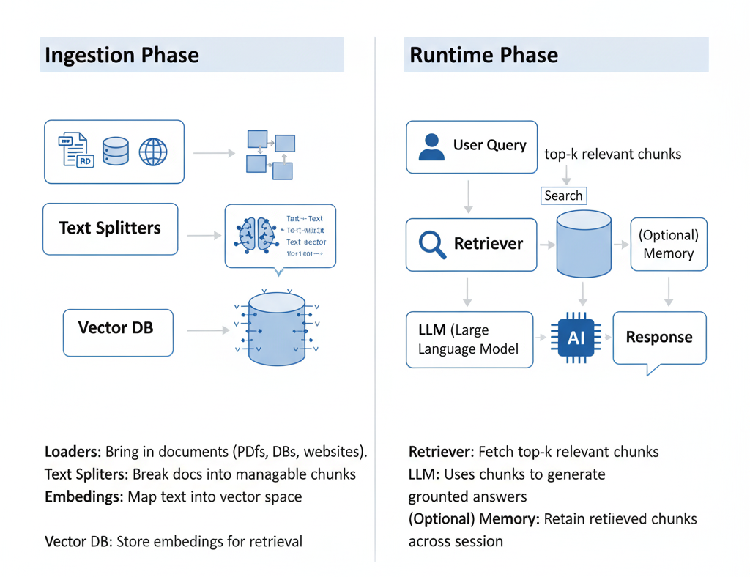
The RAG Pipeline
Loaders
Text splitters
Embeddings
Vector DB
Retriever
LLM
(Optional memory)

Slide 14
Tool‑Augmented Agents
An agent = an LLM that can decide which tool to use step by step.
Tool examples: calculator, search engine, API call, knowledge base retriever (like LlamaIndex).
Tool augmentation means you are giving the agent more abilities than just retrieval:
It can calculate.
It can search the web.
It can fetch from your vector DB (via LlamaIndex).
It can combine multiple results.

Slide 15

Combine reasoning with retrieval and external tools
Example:
Question: “What is 12×7 and what does section 3 of the contract say?”
Agent’s steps:
Use calculator tool → 12×7 = 84.
Use retriever tool → fetch contract section 3.
Combine both into a single grounded answer.

Slide 16
When to use RAG
When knowledge changes frequently.
When citations are needed.
When private/internal data must be accessed.
When reducing hallucination risk is critical.
When not to use RAG: - Simple tasks without external knowledge. - Latency‑sensitive use cases.

Slide 17
Real‑world applications
Chat with PDFs.
Legal assistants (contracts, policies).
Academic research bots.
E‑commerce assistants (product catalogs).
Customer support systems.

Slide 18
Limitations of RAG
Retrieval quality depends on embeddings.
Chunk size trade‑off: too big → noise, too small → loss of context.
Retrieval errors → wrong or incomplete answers.
Latency added due to retrieval.

Slide 19
Deciding Chunk Size in RAG
Start from the embedding model’s context window: chunking is necessary so embeddings don’t truncate input; overflowing the embedding context can discard important tokens before vectorization.
Aim for “standalone meaning”: a practical rule of thumb is that if a chunk makes sense to a human without surrounding context, it will make sense to the model—too small/too large chunks hurt retrieval precision and recall.
Understand the precision generality trade-off: smaller chunks → more precise embeddings, larger chunks → more general embeddings that can miss fine-grained details.
Use sensible defaults, then tune empirically: LlamaIndex notes defaults of chunk_size=1024 and chunk_overlap=20, and explicitly encourages customization based on data type and retrieval results.
Tune retrieval depth when you shrink chunks: when you reduce chunk size, you often need a higher `similarity_top_k` to retrieve enough coverage (LlamaIndex example halves chunk size and doubles `similarity_top_k`).
Notes:
[1]: https://www.pinecone.io/learn/chunking-strategies/ "Chunking Strategies for LLM Applications | Pinecone"
[2]: https://developers.llamaindex.ai/python/framework/optimizing/basic_strategies/basic_strategies/ "Basic Strategies | LlamaIndex OSS Documentation"

Slide 20
Best practices
Use clean, structured documents.
1
Choose chunk size carefully (200–500 tokens typical).
2
Evaluate with grounding checks and citations.
3
Combine long‑term (vector DB) with short‑term (local memory) for best results.
4

Slide 21
Summary
LangChain: orchestration, reasoning, tool use.
LlamaIndex: indexing, retrieval, observability.
Vector DB: foundation for semantic search.
Memory: temporary context persistence.
Together: Reliable, grounded, and capable agents for real‑world AI systems.

